Slide 1


CHAPTER 3:
STYLING IN REACT WITH CSS AND BUILDING REUSABLE COMPONENTS

Slide 2

Outline
INTRODUCTION TO STYLING IN REACT.
STYLED COMPONENTS.
REACT INLINE STYLING.
CSS FILES.
CSS MODULES.
SPLITTING COMPONENT AND BUILDING REUSABLE
CREATING FLEXIBLE COMPONENTS WITH STYLED COMPONENT.

Slide 3
Introduction to Styling in React
Styling is an essential part of modern web development.
While React is primarily responsible for building user interfaces and managing application logic, styling is used to control the visual appearance of components, including colors, layout, spacing, and typography.

Slide 4
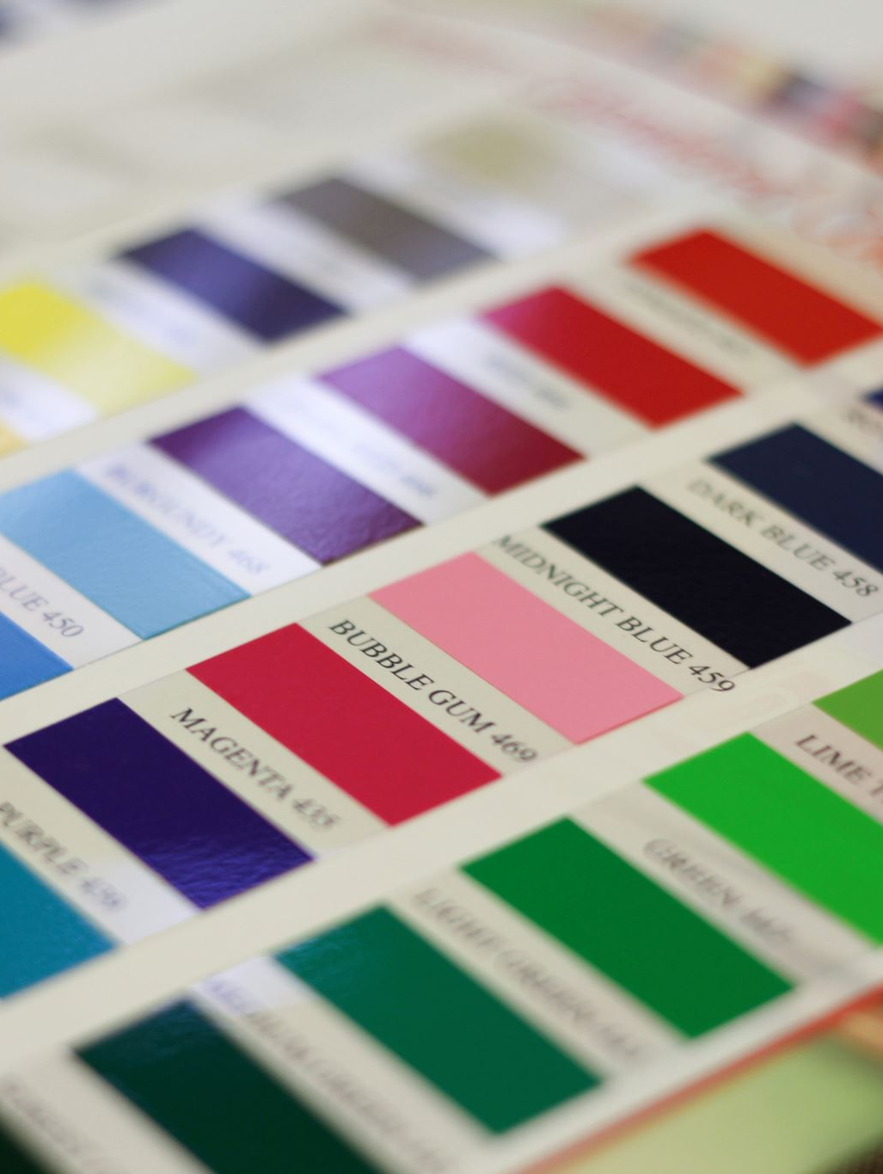
Introduction to Styling in React
In traditional web development, styling is typically applied using CSS files.
In React, developers have several different options for styling components depending on the complexity and needs of the application.
Common styling approaches in React include:
Inline Styling
External CSS Files
CSS Modules
Styled Components

Slide 5

React Inline Styling
Inline styling in React allows developers to apply styles directly within JSX using JavaScript objects.
Unlike traditional HTML, where styles are written as strings, React requires inline styles to be written as JavaScript objects using camelCase property names.
Notes:
Key Characteristics of React
1. Declarative
React allows developers to describe what the UI should look like for a given state, and it efficiently updates the DOM when the state changes.
2. Component-Based
Applications are built using reusable, independent pieces called components. Each component manages its own logic and UI.
3. Efficient
React uses a Virtual DOM to minimize direct DOM manipulation, improving performance.
4. Flexible
React focuses only on the view layer. It can be combined with other libraries for routing, state management, APIs, etc.
5. Supports SPA and More
React is commonly used to build Single Page Applications (SPAs), but it can also be used for:
Multi-page applications
Server-side rendering (SSR)
Static site generation (SSG)
Mobile apps (via React Native)

Slide 6
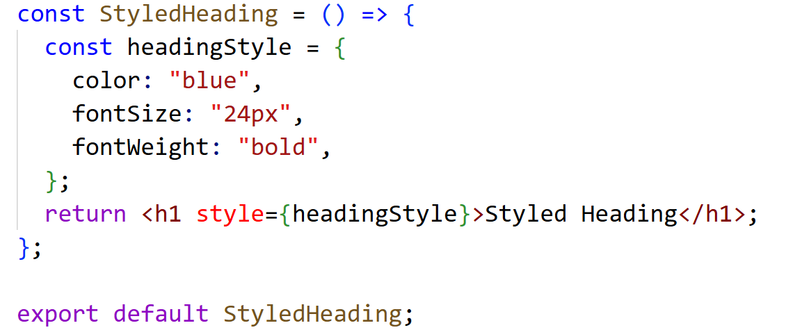
Example: Inline Styling
Explanation:
headingStyle is a JavaScript object containing CSS properties.
The style attribute receives the object using {}.
CSS properties use camelCase instead of hyphenated names (This means that properties such as font-size in CSS are written as fontSize in React, and background-color becomes backgroundColor).

Slide 7
Advantages and Limitations of Inline Styles in React
Advantages:
Useful for dynamic styling.
Easy to apply quickly.
Works well for small components.
Limitations:
Hard to maintain in large projects.
Cannot use advanced CSS features like media queries.

Slide 8
Styling with CSS Files
Another common way to style React components is by using external CSS files.
This approach is like traditional web development and is useful for applying global styles across the application.

Slide 9
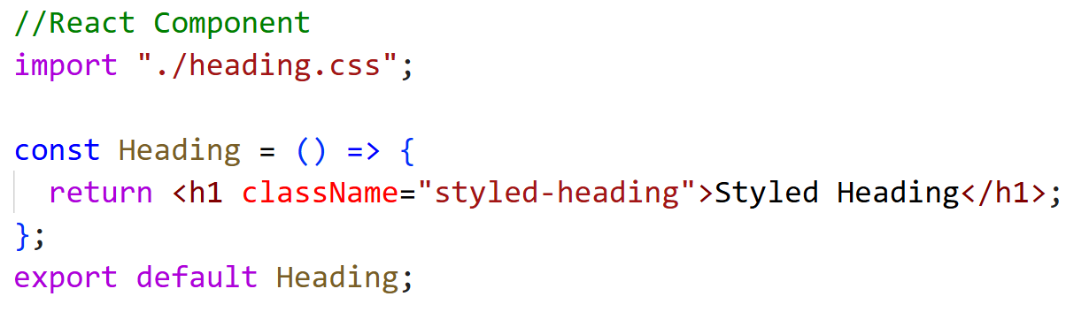
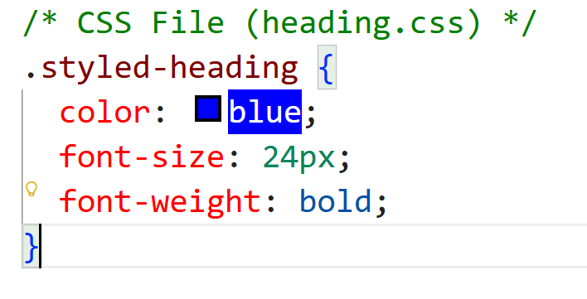
Example: Component with External CSS
The className attribute is used instead of class. This is because class is a reserved keyword in JavaScript, and since JSX is based on JavaScript syntax, React uses className to avoid conflicts.

Slide 10
CSS Modules
CSS Modules solve the problem of style conflicts by scoping CSS locally to a component.
When using CSS Modules, each class name is automatically transformed into a unique identifier, preventing naming collisions.
Advantages of CSS modules:
Prevents CSS conflicts.
Encourages modular design.
Ideal for medium to large projects.

Slide 11
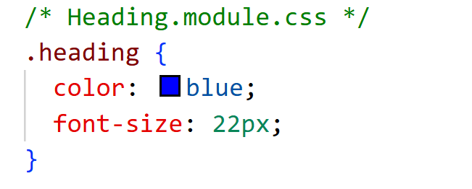
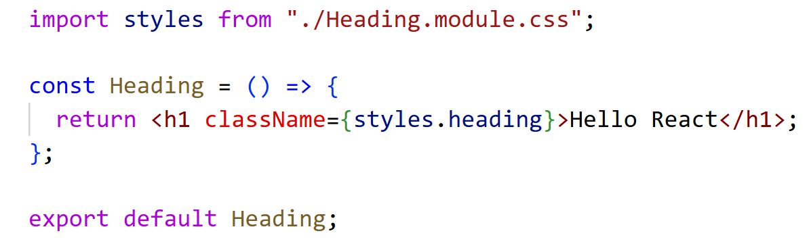
CSS Modules
Step 1: Create CSS Module
Step 2: Use CSS Module in React Component
The CSS file is imported as an object (styles).
Each class is accessed using styles.className.

Slide 12
Styled Components
Styled Components is a popular React library that allows developers to write CSS directly inside JavaScript using tagged template literals.
This method creates scoped and reusable styled components.
Installing Styled Components:
npm install styled-components

Slide 13
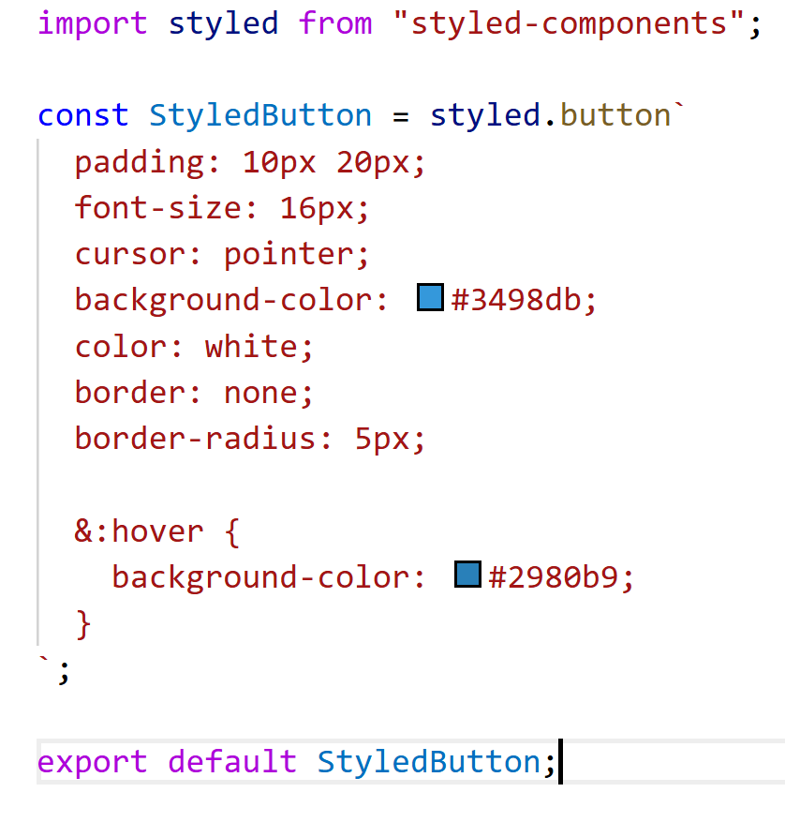
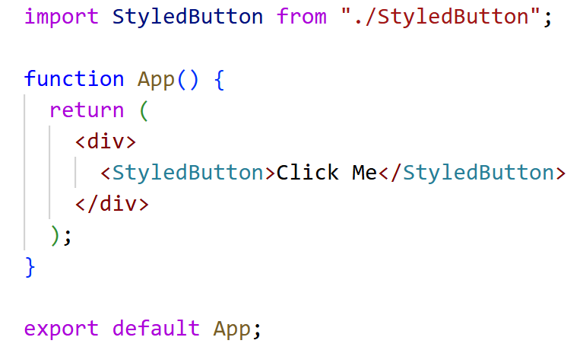
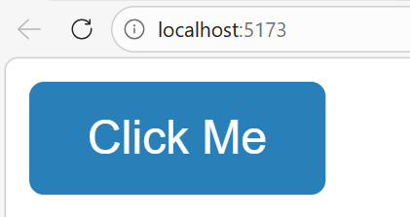
Example: Styled Button Component
Using the Styled Component:
Output:

Slide 14
Advantages of Styled Components
CSS is scoped to components
Supports dynamic styling
Helps create reusable UI components

Slide 15
Splitting Components and Building Reusable Components
One of the most important principles in React development is component reuse.
Rather than creating large, monolithic components that contain many responsibilities, developers are encouraged to divide the user interface into smaller, modular, and reusable components.
This approach improves code readability, maintainability, and scalability.
Each component is designed to perform a specific task and can be reused in multiple parts of the application

Slide 16
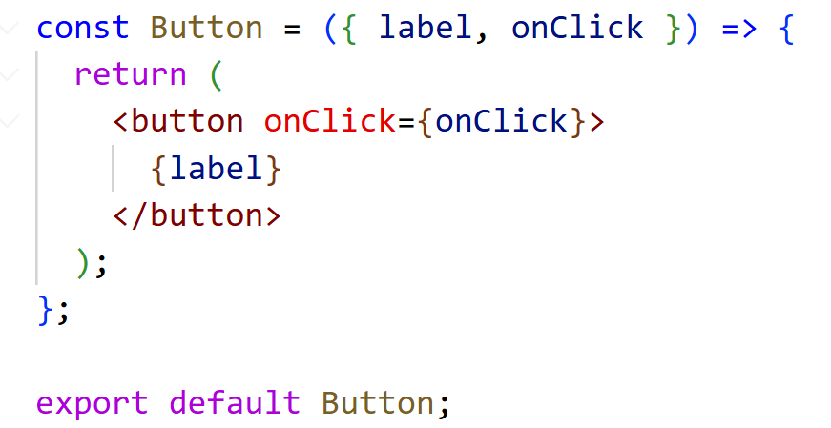
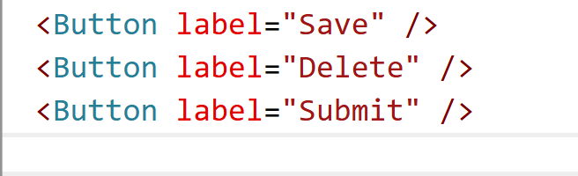
Splitting Components and Building Reusable Components
Example: Reusable Button Component
Using the Button Component
The same component can be reused with different values.

Slide 17
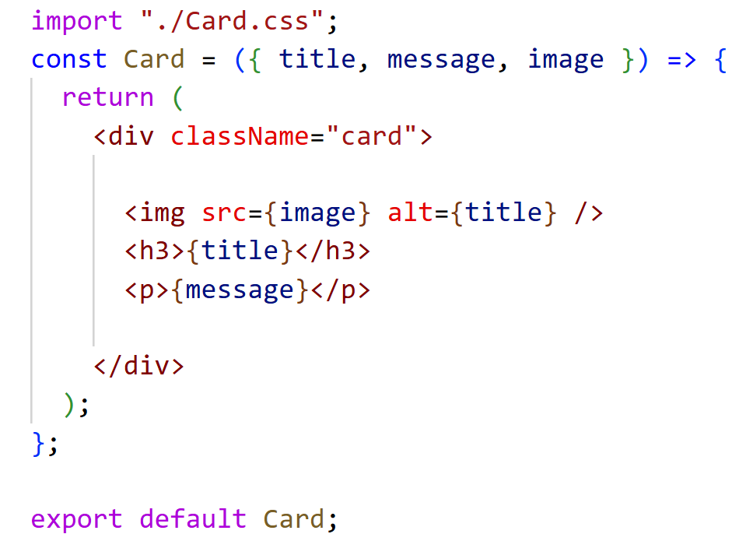
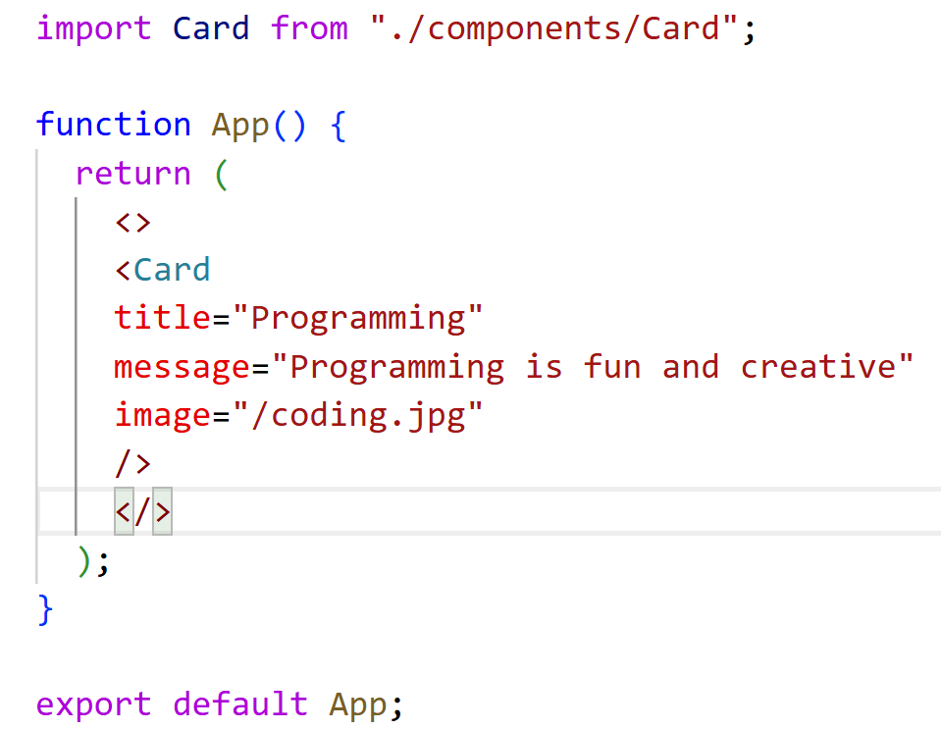
Example: Reusable Card Component
Card Component
Using the Card Component

Slide 18
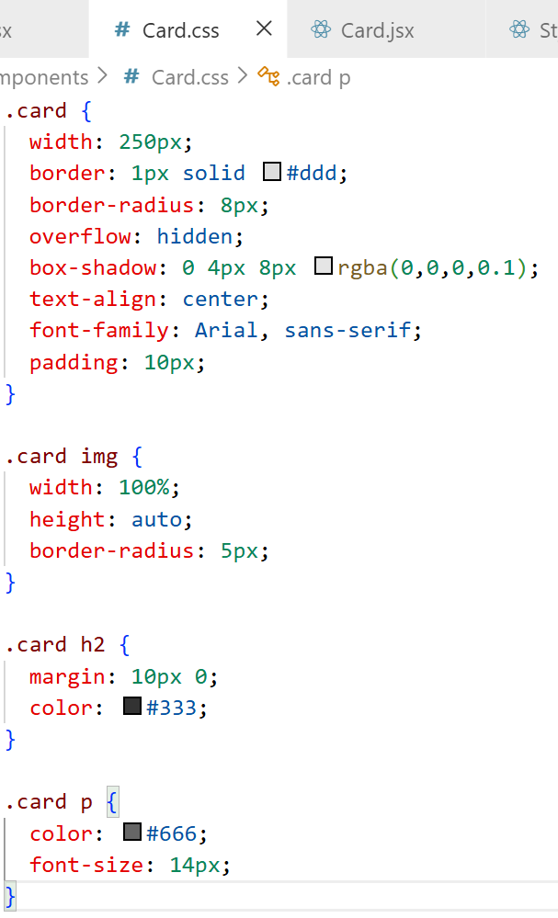


Slide 19
Tips for Styling React Components
Use Descriptive Class Names: Choose class names that describe the purpose of the element (e.g., .custom-button instead of .btn).
Avoid Inline Styles: While React allows inline styles, it’s better to use CSS files for maintainability.
Leverage CSS Modules: If you want to avoid class name conflicts, consider using CSS Modules, which scope styles to individual components.

Slide 20
Adding Images to Your React Application
Images play an important role in creating visually engaging user interfaces.
In React applications, images can be displayed inside components just like in regular HTML.
However, React projects usually use a module-based structure, so images must be handled slightly differently than in traditional HTML pages.
There are two common ways to add images in a React application:
Importing images from the project files.
Using images from an external URL.

Slide 21
Importing Images from the Project Folder
The most common approach in React is to import images directly into a component file. This ensures that the image is processed correctly by the build tool (such as Vite).

Slide 22
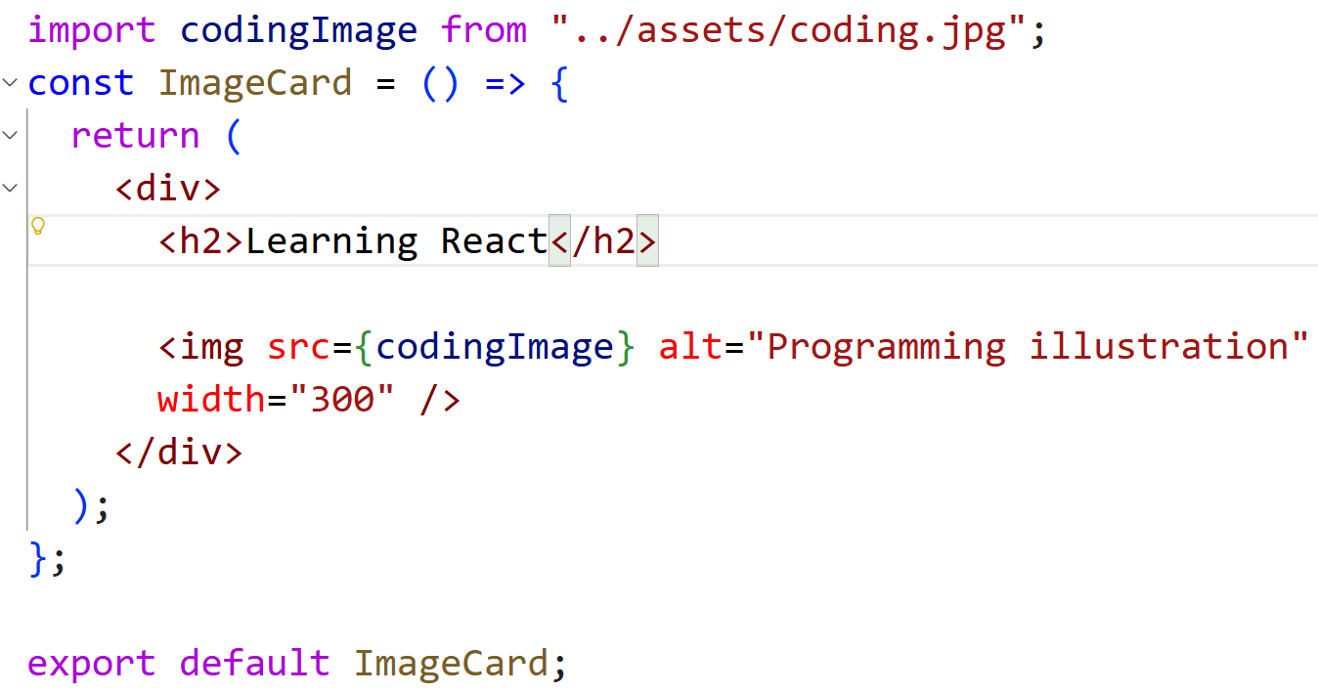
Example: Importing an Image
Suppose the image is stored inside the project folder:

Slide 23
Using Images from a Public URL
Another method is to use an image that is hosted online.
In this case, the image URL can be used directly in the src attribute.

Slide 24
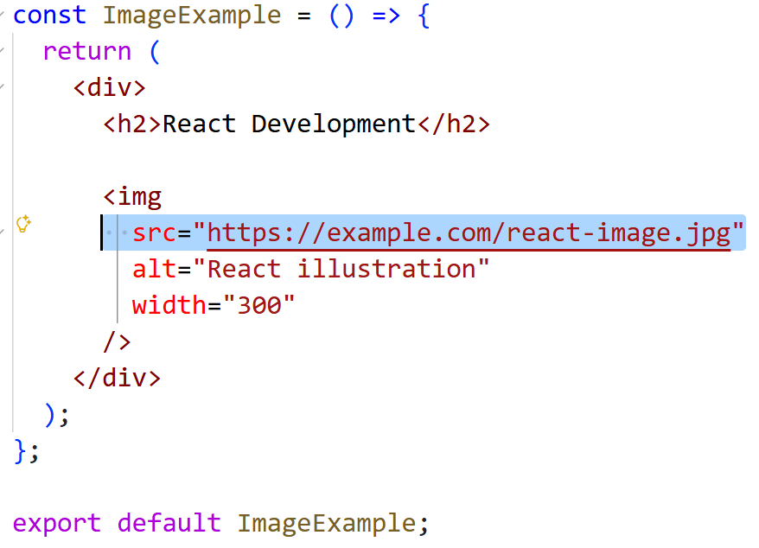
Using Images from a Public URL

Slide 25
Using the Public Folder (Alternative Method)
React projects created with Vite include a public folder where static assets can be stored.
Example structure:
public └── images └── logo.png
The image can be used as follows:
<img src="/images/logo.png" alt="Logo" />;

Slide 26
Using the Public Folder (Alternative Method)
The public folder is useful for:
logos
static images
favicon
images that do not need to be processed by the build system.

Slide 27
Best Practices for Using Images in React
To maintain clean and efficient React applications, follow these recommendations:
Store images in an assets folder inside src.
Use the import method for most images.
Always include an alt attribute for accessibility.
Avoid using very large images to improve performance.

Slide 28
END

